Slide 1
Where I can find the data about employees’ names, emails and job titles?
Employee name email job title
Stage.emp.tbl_Users | 0.95
Stage.dbi.PRTL_Vendor | 0.85
Stage.emp.tbl_TSTimesheet | 0.01
Probability that this table matches a question

Slide 2
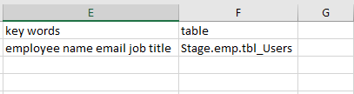
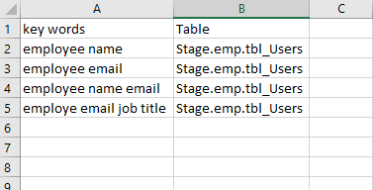
Training data set

